Slide 1
Esay Presentation of FMM
Jiayu Chen

Slide 2
Algo
Usage 1
FMM Algo
Smoothed Template (One Circle)
&
FMM Components
One Periodical Signal
Usage 2
FMM Algo
Smoothed Template (One circle)
&
FMM Components
Whole Signal

Slide 3
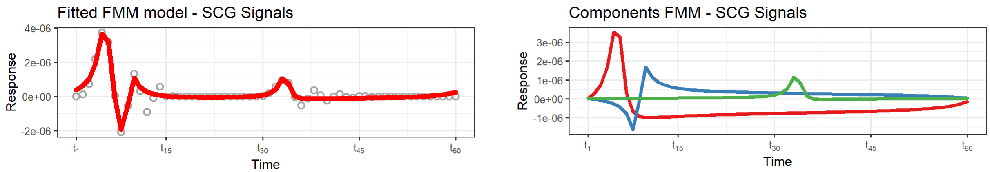
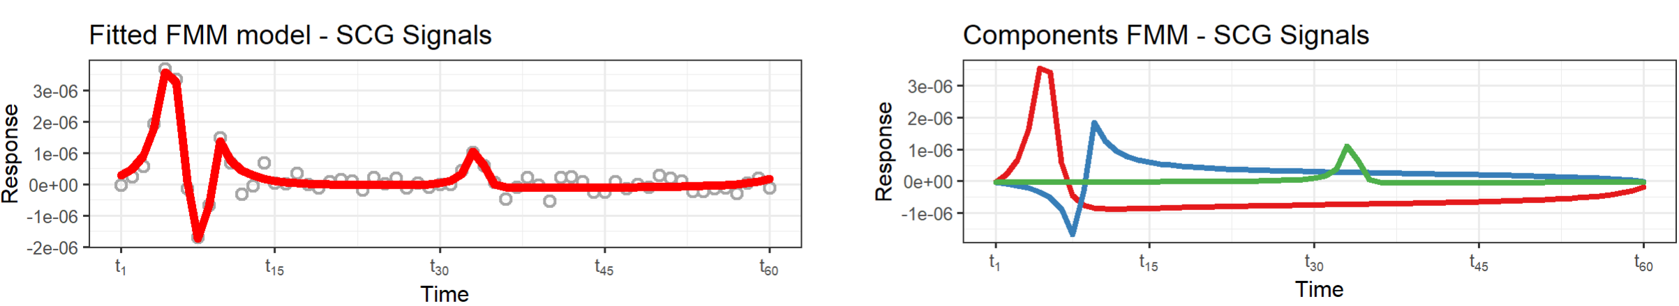
Use FMM to Denoise – White Noise
Clean 1-Cricle Signal
Clean
1-Cricle Signal with White Noise
Noisy
Fitted FMM Model are very likely. Denoising Effect is nice.
FMM Components are very likely.

Slide 4
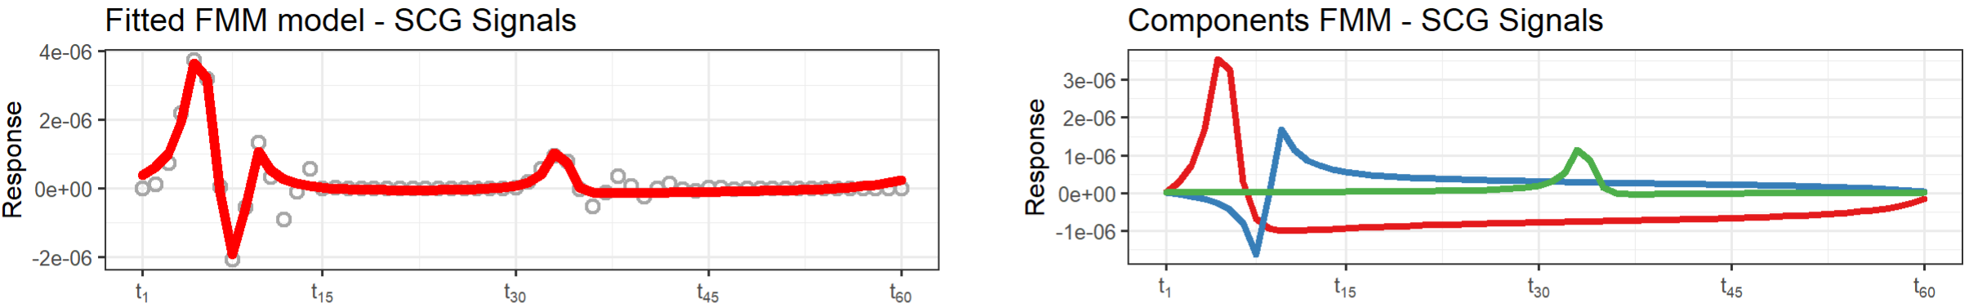
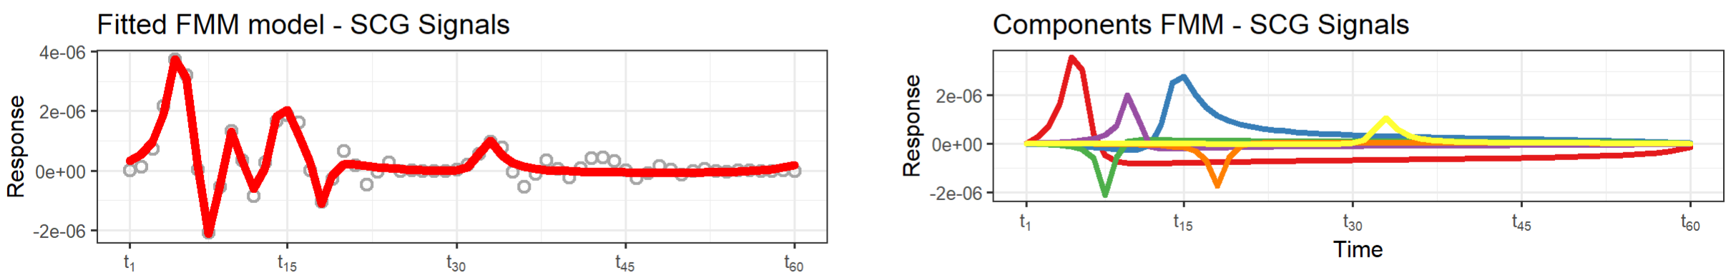
Use FMM to Denoise – Echo Noise
Clean 1-Cricle Signal
1-Cricle Signal with One Echo
(10 ms delay and 0.5 times Amplitude)
Original peak and echo peak have the same pattern.
Echo’s small peaks are treated as noise and can’t be recognized.

Slide 5
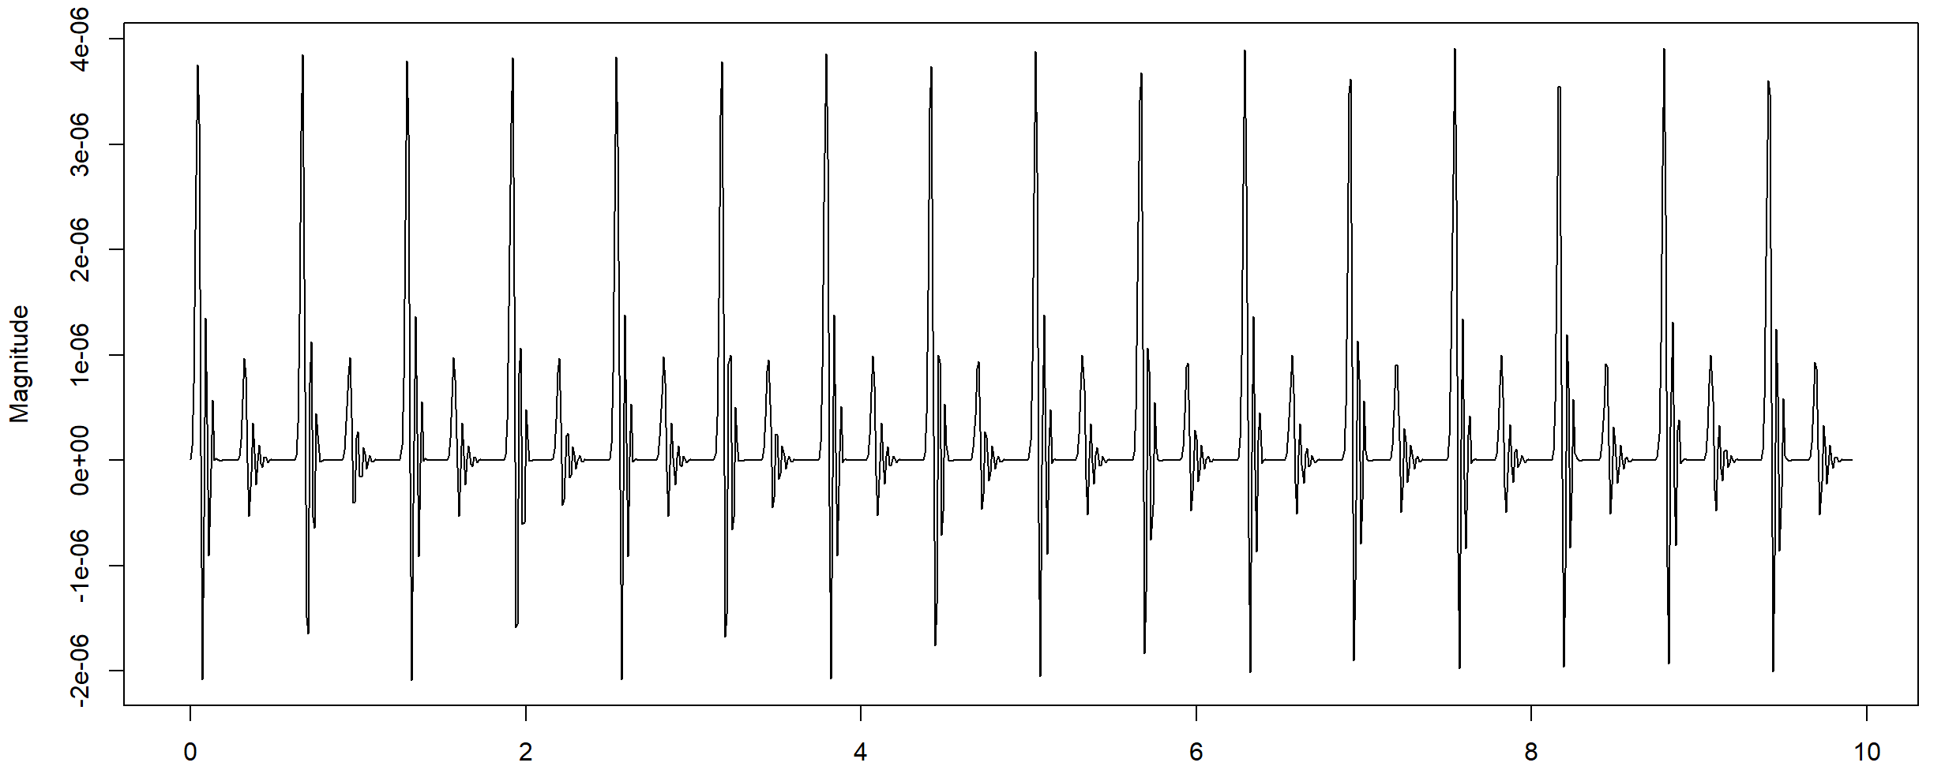
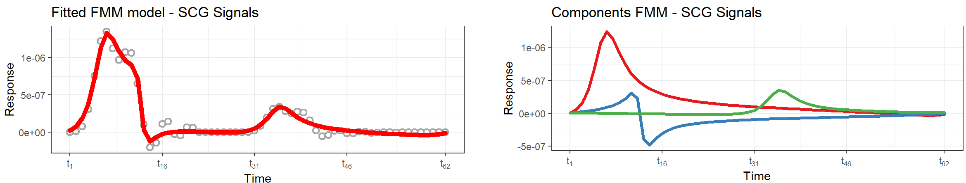
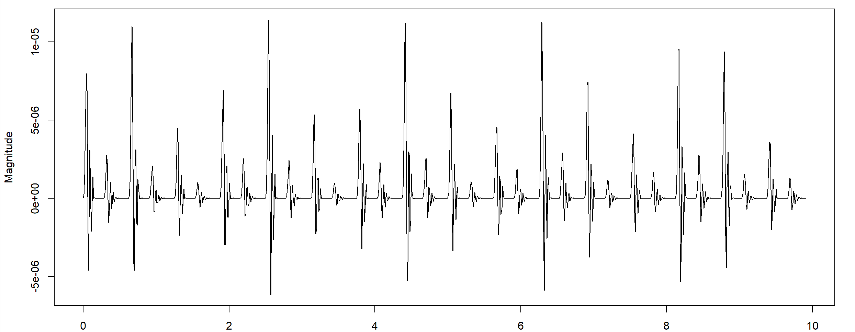
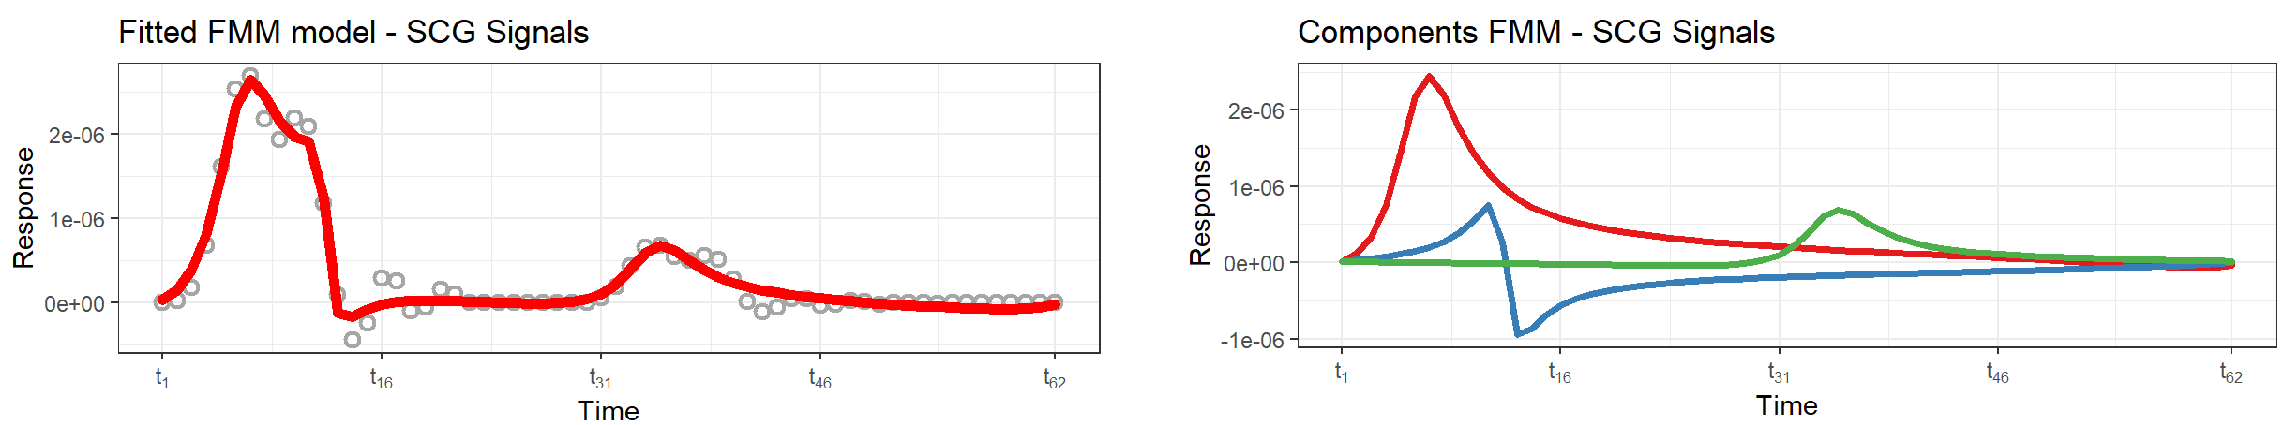
Use FMM to Denoise – Breath Noise
No Breath
Amplitudes of Fitted FMM model are different.
But their shapes are likely and the ratio of two peaks is the same.
With Breath

